Slide 1
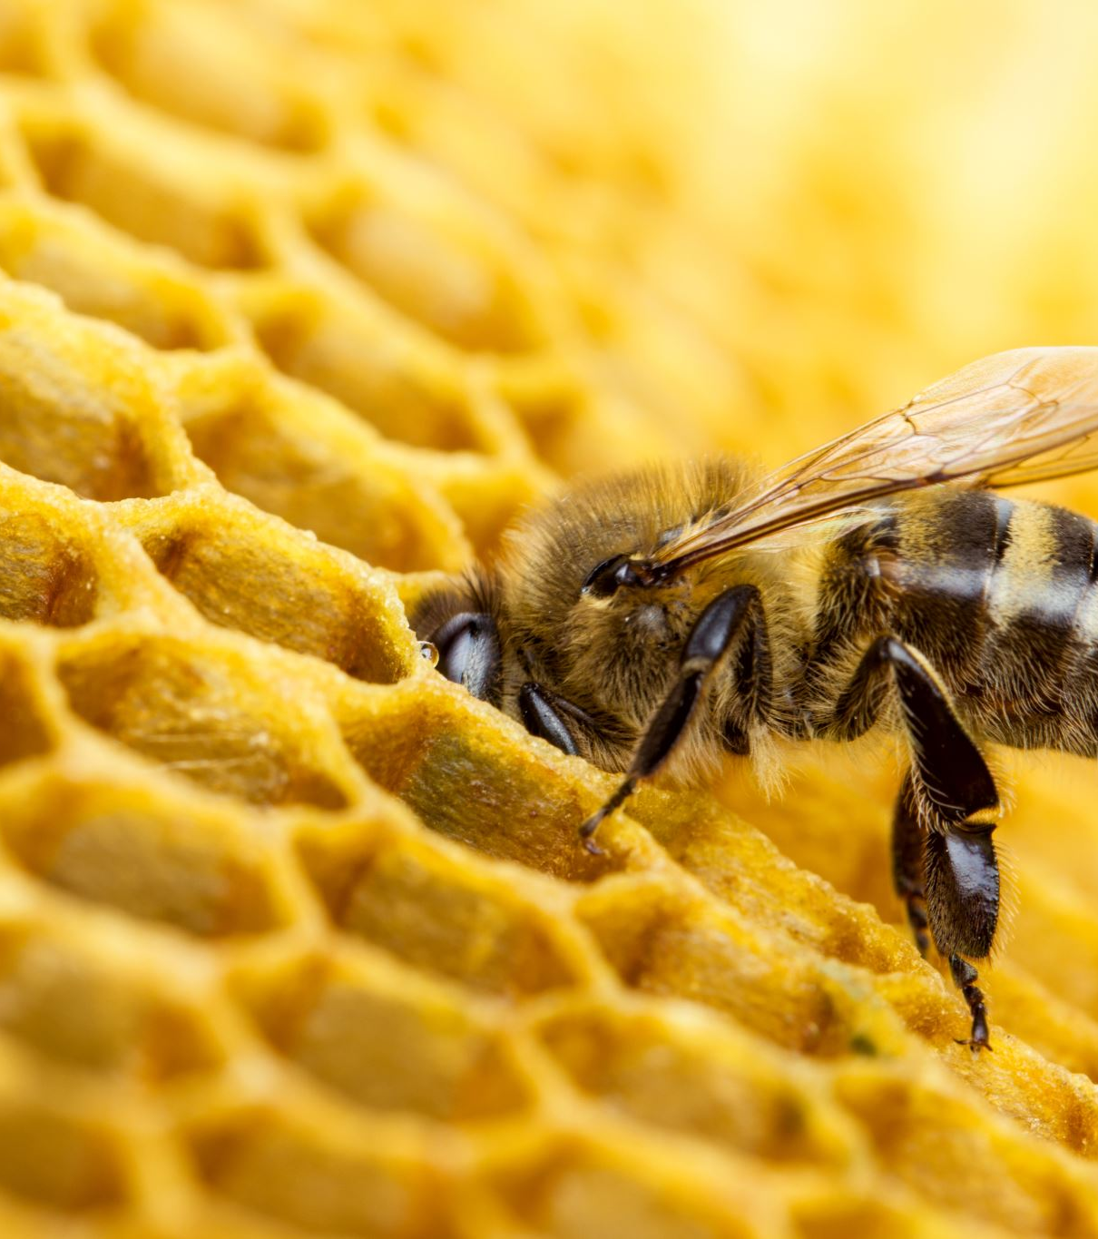
California’s New Neonicotinoid Regulations
PowerPoint Prepared by the California Department of Pesticide Regulations
June 2023

Slide 2
Overview
Neonicotinoids
Brief history
Summary of the new regulations
Definitions/Scope/Exemptions
Three classes of crops
Restrictions on each class
Timeline and next steps

Slide 3
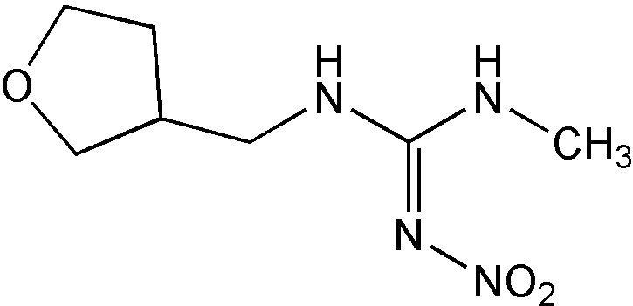
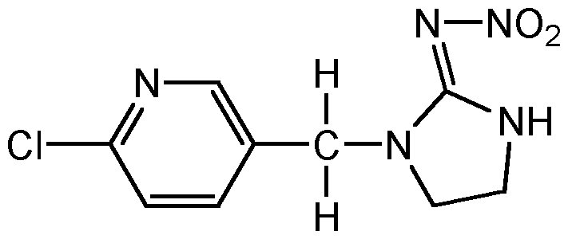
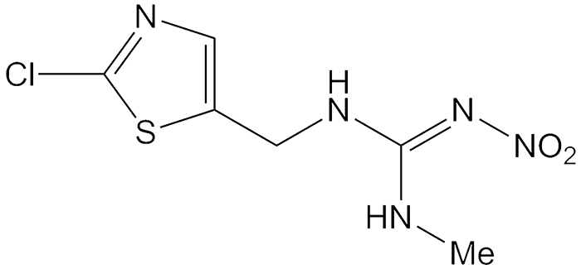
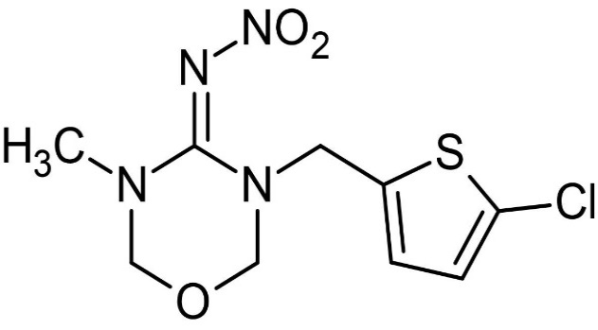
Neonicotinoids
Developed as alternatives to organophosphates and carbamates
Affect insect central nervous system, resulting in paralysis and death
Systemic pesticides
Absorbed into plants and translocated throughout plant tissues
Residues can be found in the pollen and nectar consumed by bees and other pollinators
Imidacloprid
Dinotefuran
Clothianidin
Thiamethoxam

Slide 4
Brief History
1994: Imidacloprid first registered for use in California
2008: DPR received adverse effects disclosure that showed potentially harmful effects of imidacloprid to pollinators
2009: The four neonicotinoids entered DPR reevaluation
Limited to uses to produce agricultural food or feed commodities
Did not include trees grown for lumber and wood products, Christmas trees, ornamentals and cut flowers, and turf grown commercially for sod

Slide 5
Brief History (Continued)
2014: Assembly Bill (AB) 1789 adopted FAC section 12838
July 2018: Risk Determination submitted to the Legislature
Feb 2022: Regulation noticed for public comment
April 2023: Regulation filed with Secretary of State, effective 1/1/24

Slide 6
Neonicotinoid Pesticide Exposure Protection Regulation Summary

Slide 7
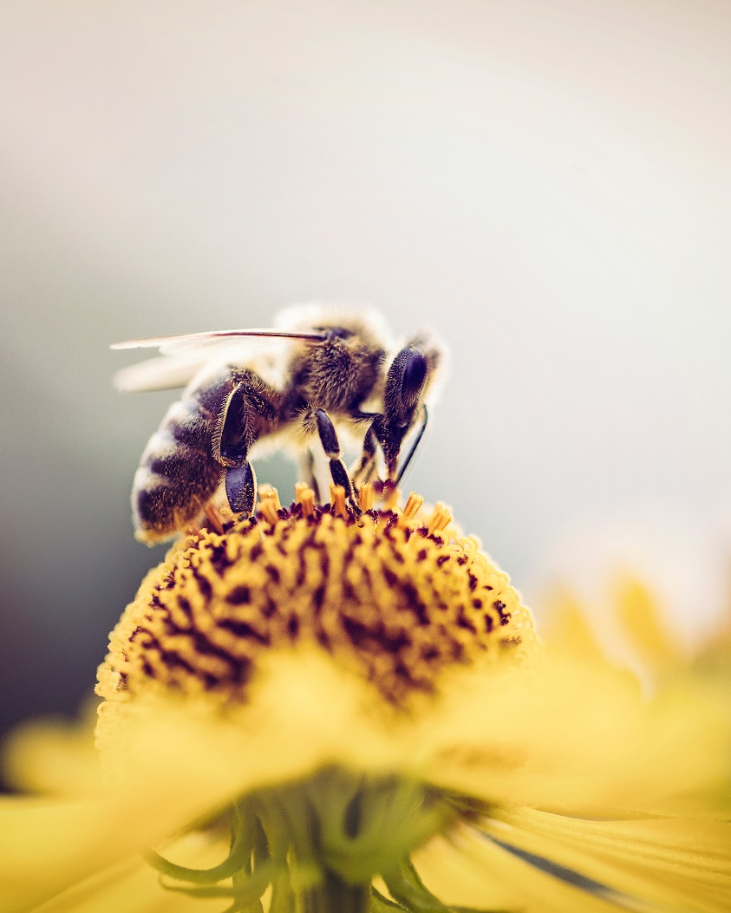
Three Definitions in Section 6990(a)
Bloom: the period from the onset of flowering until petal fall is complete
Citrus in Fresno, Kern, or Tulare follow 6984(b)
Grain crops: heading (inflorescence or tassel emergence) to harvest
Growing season: period of planting to harvest for annual or biennial crops, not more than one year for perennials
Managed pollinators: bees introduced in a field to provide pollination services to the crops in the field

Slide 8
Scope
6990(b) limits the regulations to foliar and soil applications of neonicotinoids when used to produce certain agricultural commodities.
Arranged by Crop Groupings found in 40 CFR section 180.41(c) – used for pesticide residue tolerances and referenced on many pesticide labels
Regulations do not apply to neonicotinoid use in non-agricultural (e.g., structural or home use) or non-crop (e.g., parks or cemeteries) settings, or to applications to nursery stock
This Photo by Unknown Author is licensed under CC BY-SA-NC
almond blossoms

Slide 9
Exemptions
Examples of some exempted applications in section 6990(c):
In enclosed spaces or insect exclusionary structures/netting
To control a quarantine pest
Under a FIFRA Section 18 emergency exemption
Also, a crop group section may list crops that are exempt from the article (ex: mulberries in Berries and Small Fruit)
This Photo by Unknown Author is licensed under CC BY-SA
Netting used to keep out insects

Slide 10
Crop Group Restrictions
Sections 6990.1 – 6990.16
Three broad crop group categories:
Crops normally harvested before bloom
Crops normally harvested after bloom
Certain other crops where DPR was not able to determine the combinations of application rates and timings that are safe or low risk to pollinators

Slide 11
Crops Which Are Normally Harvested Before Bloom
Crop groups (example crops)
Bulb vegetables (e.g., garlic)
Herbs and spices (e.g., basil, thyme)
Leafy Vegetables including Brassica (e.g., asparagus, celery, broccoli, kale, lettuce, spinach)
Certain miscellaneous crops (artichokes)
Certain root and tuber vegetables normally harvested before bloom (e.g., carrots, beets, parsnips, radishes)

Slide 12
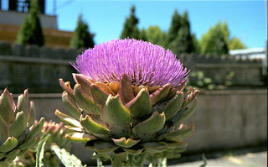
Restrictions on Crops Which Are Normally Harvested Before Bloom
When the crop is harvested before bloom, the crop is not subject to the article. Follow neonicotinoid product label instructions.
However, if the crop will bloom (e.g., for seed production), neonicotinoid use is prohibited on the crop.
For root and tuber vegetables harvested after bloom or grown for seed, follow next section instead
This Photo by Unknown Author is licensed under CC BY-ND
artichoke blossoms

Slide 13
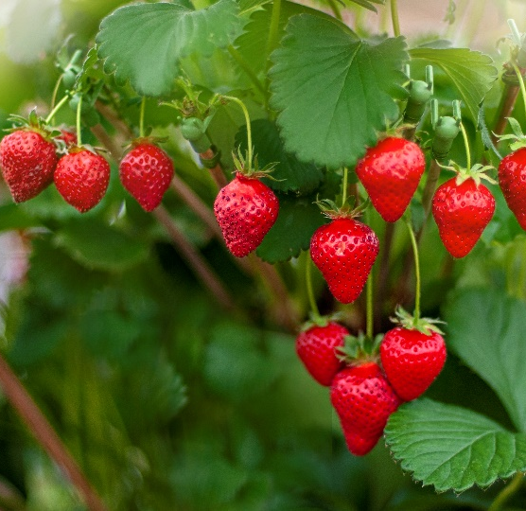
Crops Which Are Normally Harvested After Bloom
Crop groups (example crops)
Strawberry plant
Berries and small fruits (e.g., grape, raspberry)
Cereal grains* (e.g., corn)
Citrus fruits (e.g., lemon, orange)
Cucurbit vegetables (e.g., cucumber, pumpkin)
Fruiting vegetables (e.g., tomato)
Legume vegetables (e.g., bean, pea)
Oilseed crops (e.g., canola, sunflower)
Pome fruits (e.g., apple, pear)
Other root and tuber vegetables (e.g., potatoes)
Stone fruits (e.g., cherry, peach)
Tree nuts (e.g., almond, walnut)

Slide 14
Restrictions on Crops Which Are Normally Harvested After Bloom
Use is prohibited during bloom.
Additional use restrictions if multiple AIs or both soil and foliar application methods are used on the crop during the growing season.
Additional use restrictions if managed pollinators will be used with the crop during the growing season.
Additional restrictions for certain crops.
Orange tree

Slide 15
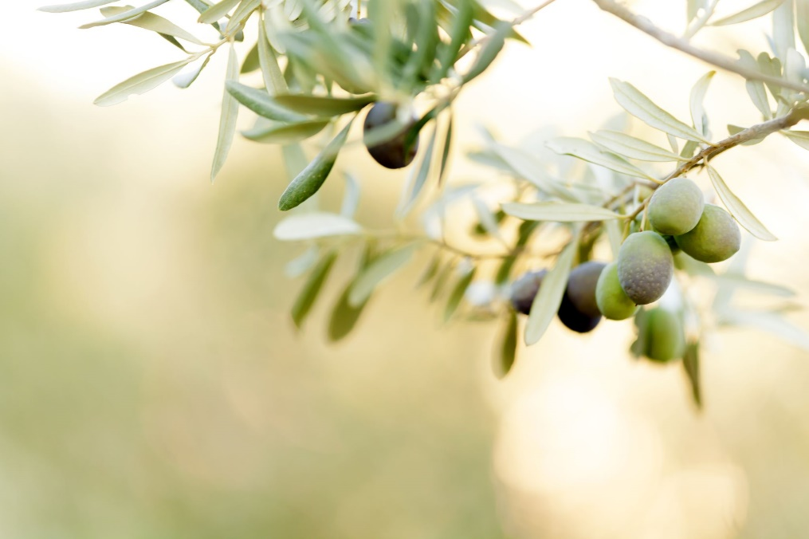
Other Crops
Crop groups (example crops)
Tropical and subtropical fruit, edible peel (e.g., date, fig, olive)
Tropical and subtropical fruit, inedible peel (e.g., avocado, pomegranate, prickly pear fruit)
Certain miscellaneous crops (coffee and peanuts)
Reminder: These are the crops where DPR was not able to determine the combinations of application rates and timings that are safe or low risk to pollinators
olive tree

Slide 16
Restrictions on Other Crops
Use is prohibited during bloom.
Only one neonicotinoid AI is permitted per growing season.
Only one application method (soil or foliar) is permitted per growing season.
If managed pollinators will be used with the crop, neonicotinoid use is prohibited.
avocado blossom

Slide 17
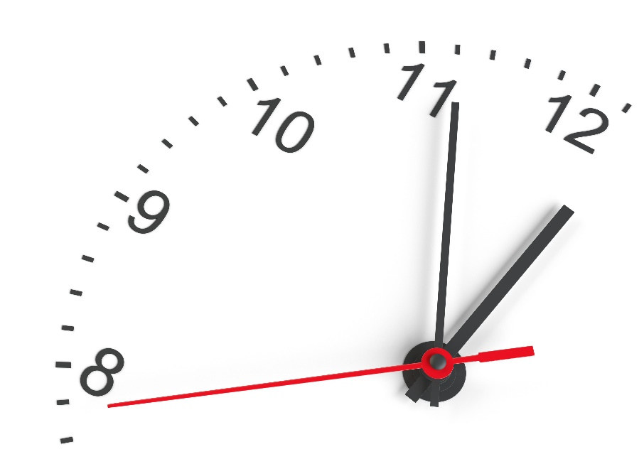
Timeline & Next Steps in California
Regulation filed with Secretary of State on 4/10/23
Regulation effective 1/1/24
DPR planning outreach activities

Slide 18
A Last Note
The neonicotinoid AIs are currently undergoing Registration Review at EPA
Feb 2020: Released Proposed Interim Decisions (PIDs)
Fall 2023: Anticipate releasing amended PIDs that will include additional mitigation measures to reduce neonicotinoid exposures for non-target organisms, including some listed species
2024: Anticipates releasing Interim Decision and final listed species biological evaluation
Any needed label changes to follow
Excerpt of 2020 Imidacloprid PID Table of Contents

Slide 19
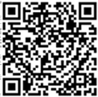
Questions?
For more information on the regulations, visit the following links: www.cdpr.ca.gov/neonicotinoiduse/
https://www.cdpr.ca.gov/docs/legbills/rulepkgs/22-001/22-001.htm

